Slide 1
ECE/CS 552: Pipelining and Exceptions
© Prof. Mikko Lipasti
Lecture notes based in part on slides created by Mark Hill, David Wood, Guri Sohi, John Shen and Jim Smith

Slide 2
Exceptions
What happens?
Instruction fetch page fault
Illegal opcode
Privileged opcode
Arithmetic overflow
Data page fault
I/O device status change
Power-on/reset

Slide 3
Exceptions
For some, we could test for the condition
Arithmetic overflow
I/O device ready (polling)
But most tests uselessly say “no”
Solution:
Surprise “procedure call”
Called an exception

Slide 4
Exceptions: Big Picture
Two types:
Interrupt (asynchronous) or
Trap (synchronous)
Hardware handles initial reaction
Then invokes a software exception handler
By convention, at e.g. 0xC00
O/S kernel provides code at the handler address

Slide 5
Exceptions: Hardware
Sets state that identifies cause of exception
MIPS: in exception_code field of Cause register
Changes to kernel mode for dangerous work ahead
Disables interrupts
MIPS: recorded in status register
Saves current PC (MIPS: exception PC)
Jumps to specific address (MIPS: 0x80000080)
Like a surprise JAL – so can’t clobber $31

Slide 6
Exceptions: Software
Exception handler:
MIPS: .ktext at 0x80000080
Set flag to detect incorrect entry
Nested exception while in handler
Save some registers
Find exception type
E.g. I/O interrupt or syscall
Jump to specific exception handler

Slide 7
Exceptions: Software, cont’d
Handle specific exception
Jump to clean-up to resume user program
Restore registers
Reset flag that detects incorrect entry
Atomically
Restore previous mode (user vs. supervisor)
Enable interrupts
Jump back to program (using EPC)

Slide 8
Implementing Exceptions
We worry only about hardware, not s/w
IntCause
0 undefined instruction
1 arithmetic overflow
Changes to the datapath
Detect exception
Additional source for next PC
Storage for exception cause, return address, spare register
Additional complexity in control logic

Slide 9
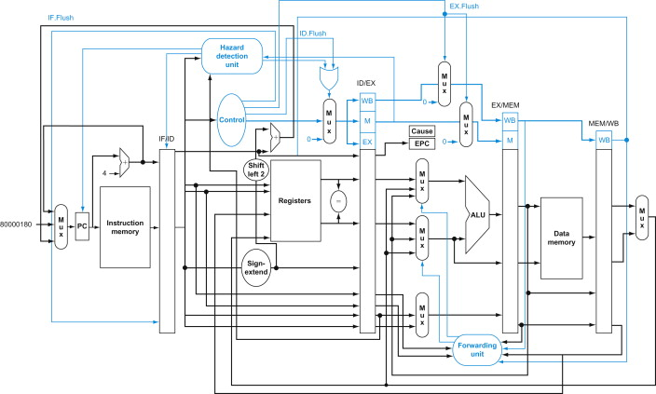
Pipeline With Exceptions (Fig 4.66)

Slide 10
Summary and Review
Exceptions
Handling exceptions in a pipelined design

