Slide 1
ECE/CS 552: Nanophotonics
Instructor: Mikko H Lipasti
Fall 2010
University of Wisconsin-Madison
Optional lecture – just for “fun”

Slide 2
Good News
Technology advances at astounding rate
  19th century: attempts to build mechanical computers
  Early 20th century: mechanical counting systems (cash registers, etc.)
  Mid 20th century: vacuum tubes as switches
  Since: transistors, integrated circuits
1965: Moore’s law [Gordon Moore]
  Predicted doubling of IC capacity every 18 months
Drives functionality, performance, cost
  Exponential improvement for 40+ years
  Built on Von Neumann model (fetch/execute)

Slide 3
Distributed processing on chip
Future chips rely on distributed processing
  Many computation/cache/DRAM/IO nodes
  Placement, topology, core uarch/strength, tbd
Conventional interconnects may not suffice
  Buses not viable
  Crossbars are slow, power-hungry, expensive
  NOCs impose latency, power overhead
Nanophotonics to the rescue
  Communicate with photons
  Inherent bandwidth, latency, energy advantages
  Silicon integration becoming a reality
Challenges & opportunities remain

Slide 4
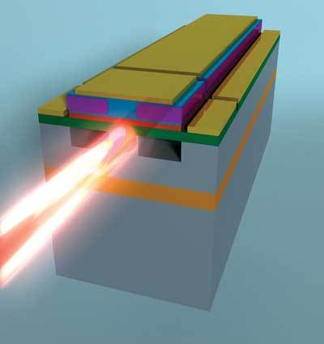
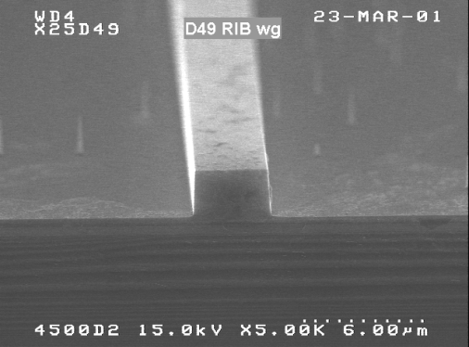
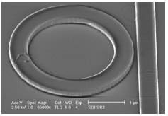
Si Photonics: How it works
Laser
Off-Chip Power
[Koch ‘07]
0.5 μm
Waveguide
Optical Wire
~3.5 μm
[Intel]
Ring Resonator
Wavelength Magnet
OFF
ON
[HP]
Notes:
Density – 8 and .25 global wires can fitin one waveguide… we fit 64 wavelengths. We win.
Transistor dimensions specified as Width /
Length
– Minimum size 4λ / 2λ, sometimes called 1 unit
– In f = 0.6 μm process, this is 1.2 μm wide, 0.6
μm long
40 nm width at level 1, is 12 wires worth.

Slide 5
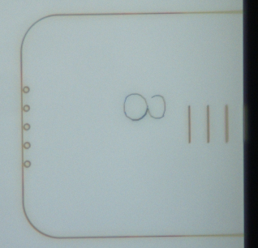
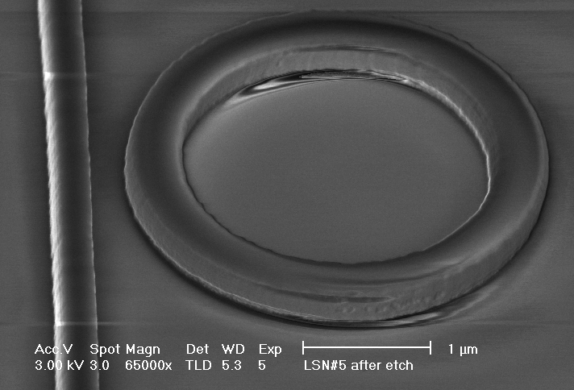
Ring Resonators
OFF
ON : Diverting
ON : Diverting
+ Detecting
ON : Injecting

Slide 6
Key attributes of Si photonics
Very low latency, very high bandwidth
Up to 1000x energy efficiency gain
Challenges
  Resonator thermal tuning: heaters
  Integration, fabrication, is this real?
Opportunities
  Static power dominant (laser, thermal)
  Destructive reads: fast wired or

Slide 7
Nanophotonics
Nanophotonics overview
Sharing the nanophotonic channel
  Light-speed arbitration [MICRO 09]
Utilizing the nanophotonic channel
  Atomic coherence [HPCA 11]

Slide 8
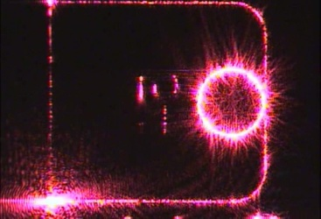
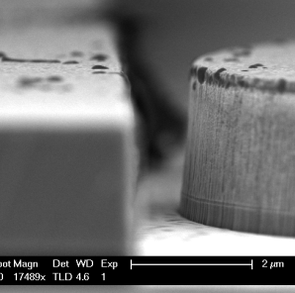
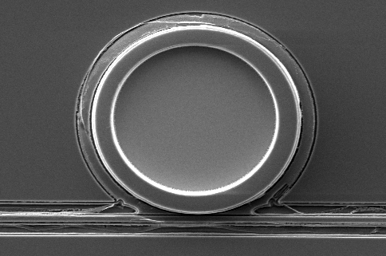
Corona substrate [ISCA08]
Targeting Year 2017
  Logically a ring topology
  One concentric ring per node
  3D stacked: optical, analog, digital

Slide 9
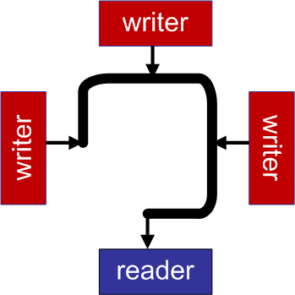

Multiple writer single reader (MWSR) interconnects
latchless/
wave-pipelined
Arbitration prevents corruption of in-flight data

Slide 10
Motivating an optical arbitration solution
MWSR Arbiter must be:
Global - Many writers requesting access
Very fast – Otherwise bottleneck
Optical arbiter avoids OEO conversion delays, provides light-speed arbitration

Slide 11
Proposed optical protocols
Token-based protocols
  Inspired by classic token ring
  Token == transmission rights
  Fits well with ring-shaped interconnect
  Distributed, Scalable
  (limited to ring)

Slide 12
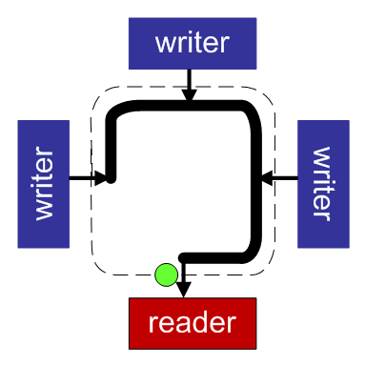
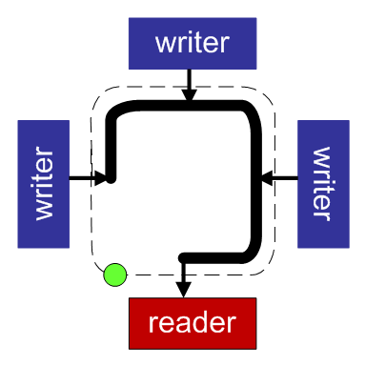
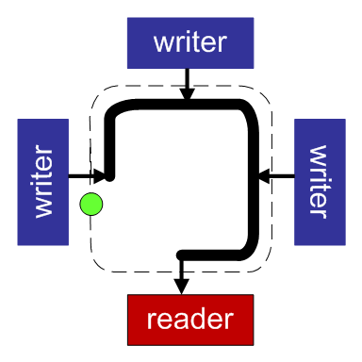
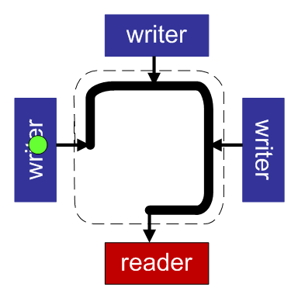
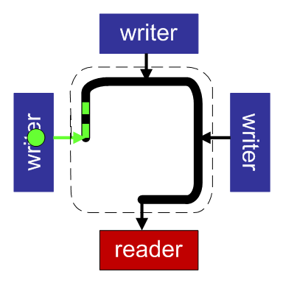
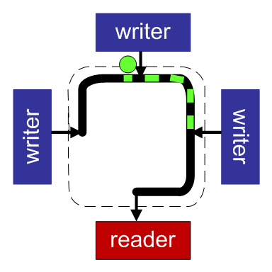
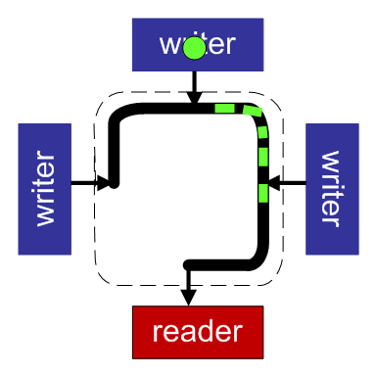

Baseline
Based on traditional token protocols
Repeat token at each node
  But data is not repeated!
  Poor utilization
Interconnect bubble
(grows linearly
with # of non-requesters)

Slide 13







Optical arbitration basics
Token - Inject | Token - Seize | Token - Pass
Power
Ring resonator
Waveguide
No Repeat!
Token latency bounded by the time of flight between requesters.

Slide 14
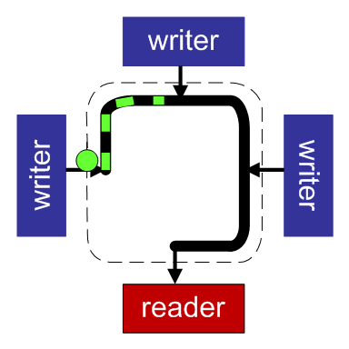
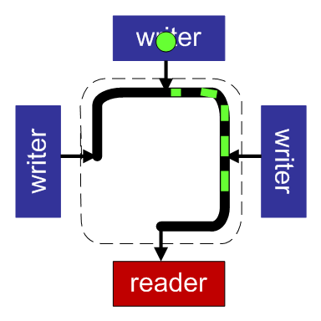
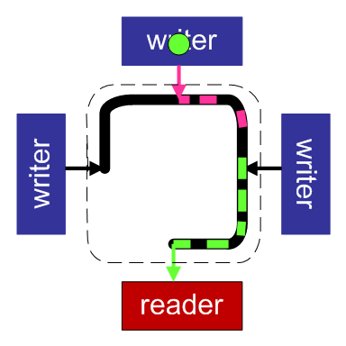
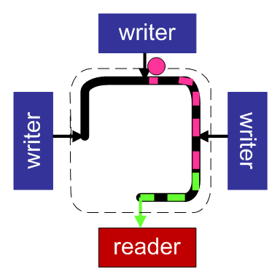
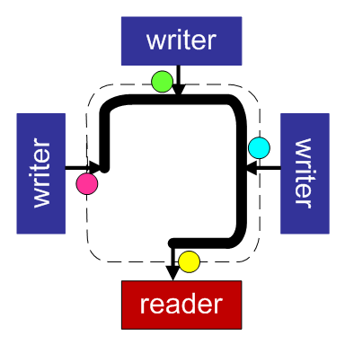
Token Slot
Arbitration solutions
Token Channel
Single Token / Serial Writes
Multiple Tokens / Simultaneous Writes
Token passing allows token to pace transmission tail (no bubbles)
Token passing allows token to directly precede slot

Slide 15
Flow control and fairness
Flow Control:
Use token refresh as opportunity to encode flow control information (credits available)
Arbitration winners decrement credit count
Fairness:
Upstream nodes get first shot at tokens
Need mechanism to prevent starvation of downstream nodes

Slide 16
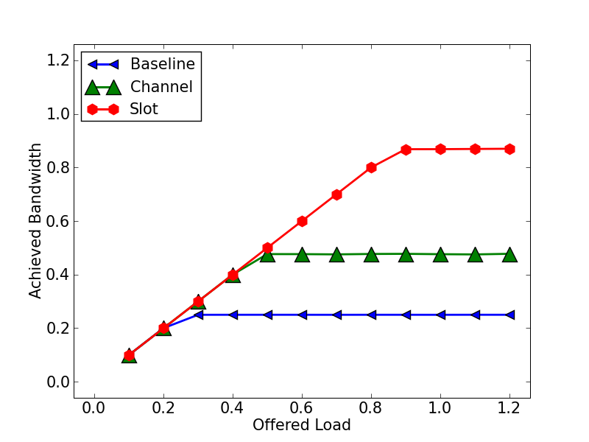
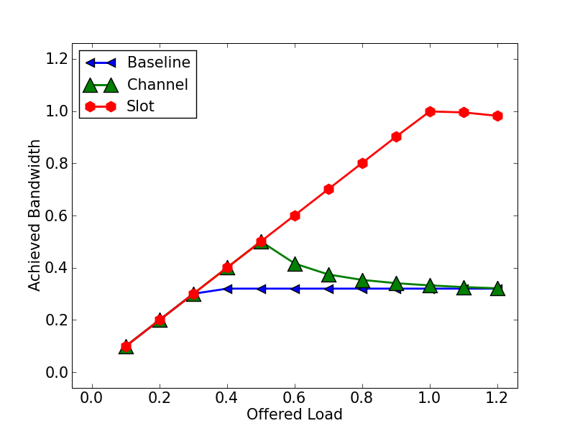
Results - Performance
Uniform
HotSpot
Token Slot benefits from
the availability of multiple tokens (multiple writers)
fast turn-around time of flow-control mechanism

Slide 17
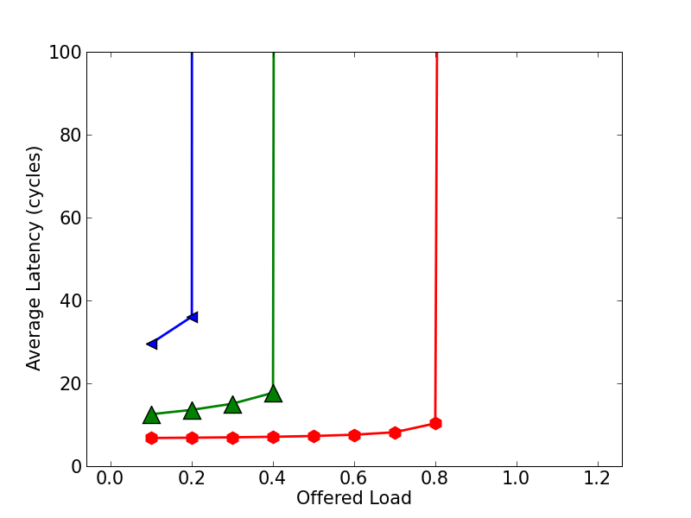
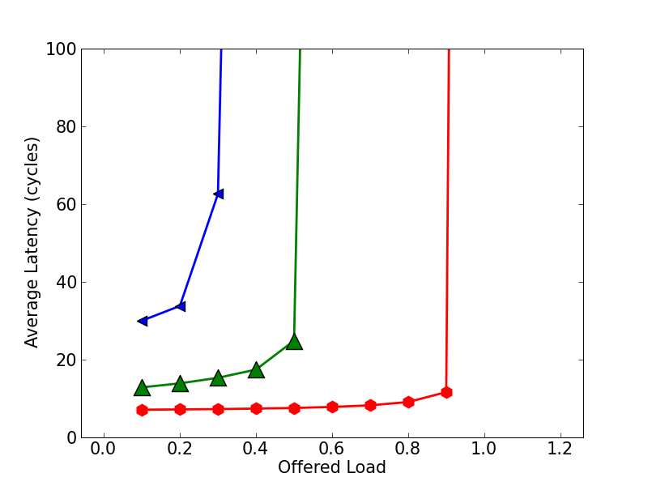

Results - Latency
Uniform
HotSpot
Token Slot has the lowest latency and saturates at 80%+ load

Slide 18
Optical arbitration summary
Arbitration speed has to match transfer speed for fine-grained communication
  Arbiter has to be optical
High throughput is achievable
  85+% for token slot
Limited to simple topologies (MWSR)
Implementation challenges
  Opt-elec-logic-elec-opt in 200ps (@5GHz)

Slide 19
Nanophotonics
Nanophotonics overview
Sharing the nanophotonic channel
  Light-speed arbitration [MICRO 09]
Utilizing the nanophotonic channel
  Atomic coherence [HPCA 11]

Slide 20
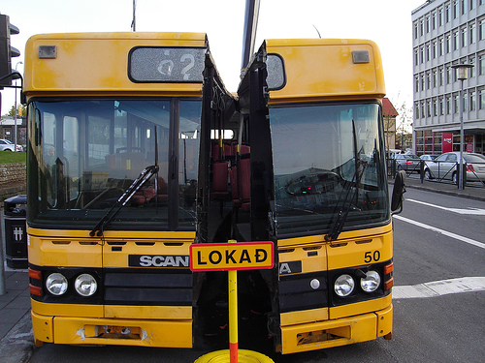
What makes coherence hard?
Unordered interconnects
  split transaction buses,
  meshes, etc
Speculation
  Sharer-prediction, speculative data use, etc.
Multiple initiators of coherence requests
  L1-to-L2, Directory Caches, Coherence Domains, etc
→State-event pair explosion
→Verification headache

Slide 21
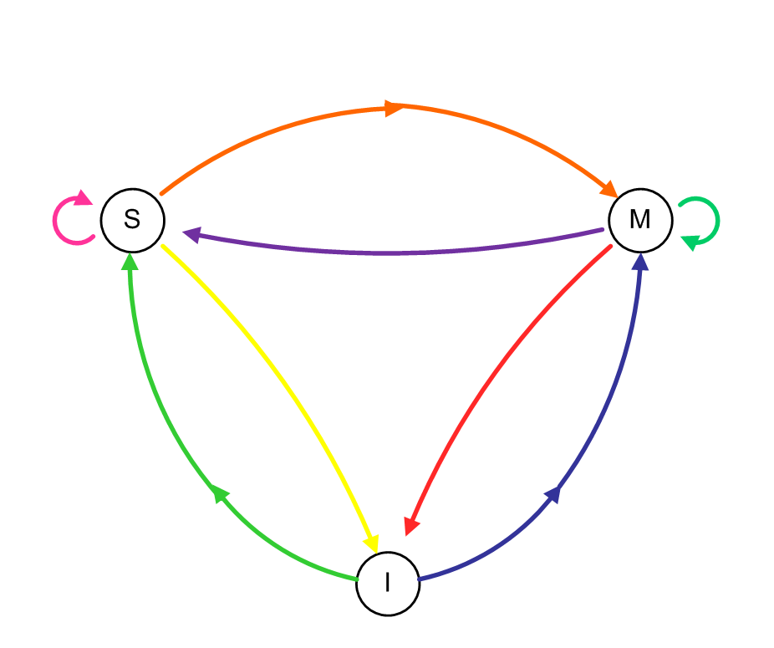
Example: MSI (SGI-Origin-like, directory, invalidate)
Stable States
Notes:
rules that govern the reading/writing of cached data

Slide 22
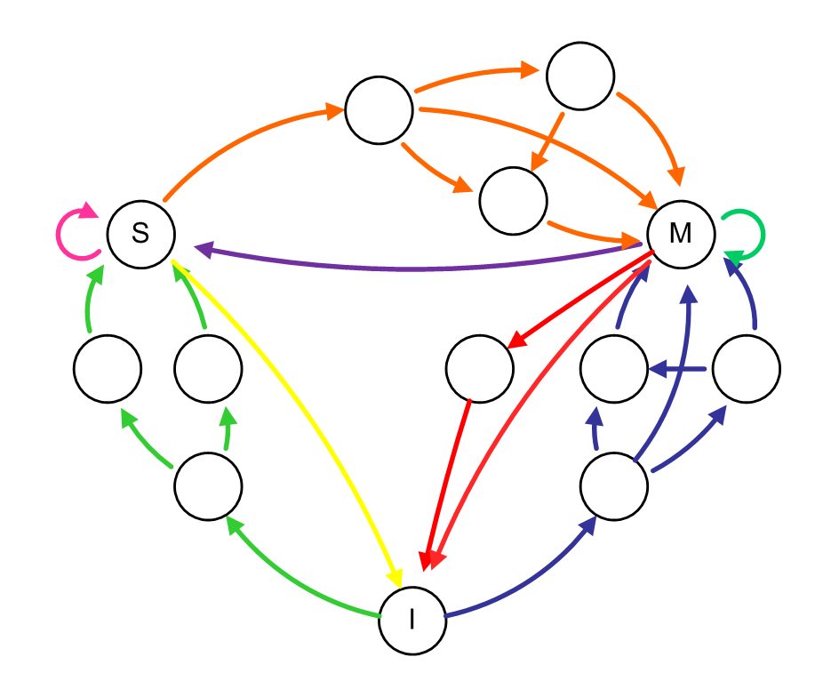
Example: MSI (SGI-Origin-like, directory, invalidate)
Stable States
Busy States

Slide 23
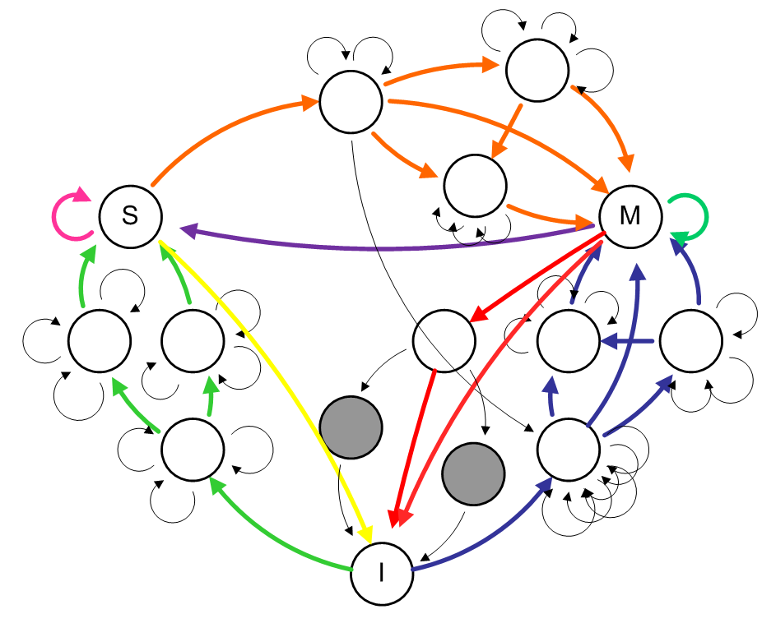
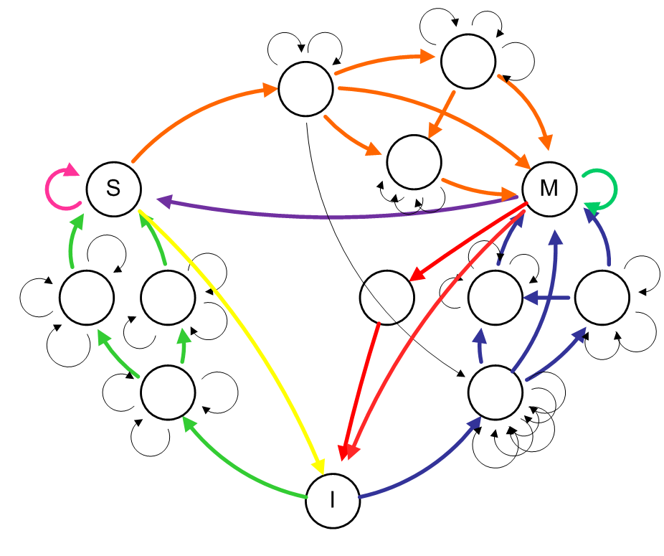
Example: MSI (SGI-Origin-like, directory, invalidate)
Stable States
Busy States
Races
“unexpected” events from concurrent requests to same block
Notes:
Grey states -- Get intervention while doing writeback.
Grey0 = got intervention, dunno what to do with it, waiting for message from directory
Grey1 = got message from directory of race, waiting for intervention
Grey0/1 = reordering of intervention and directory message

Slide 24
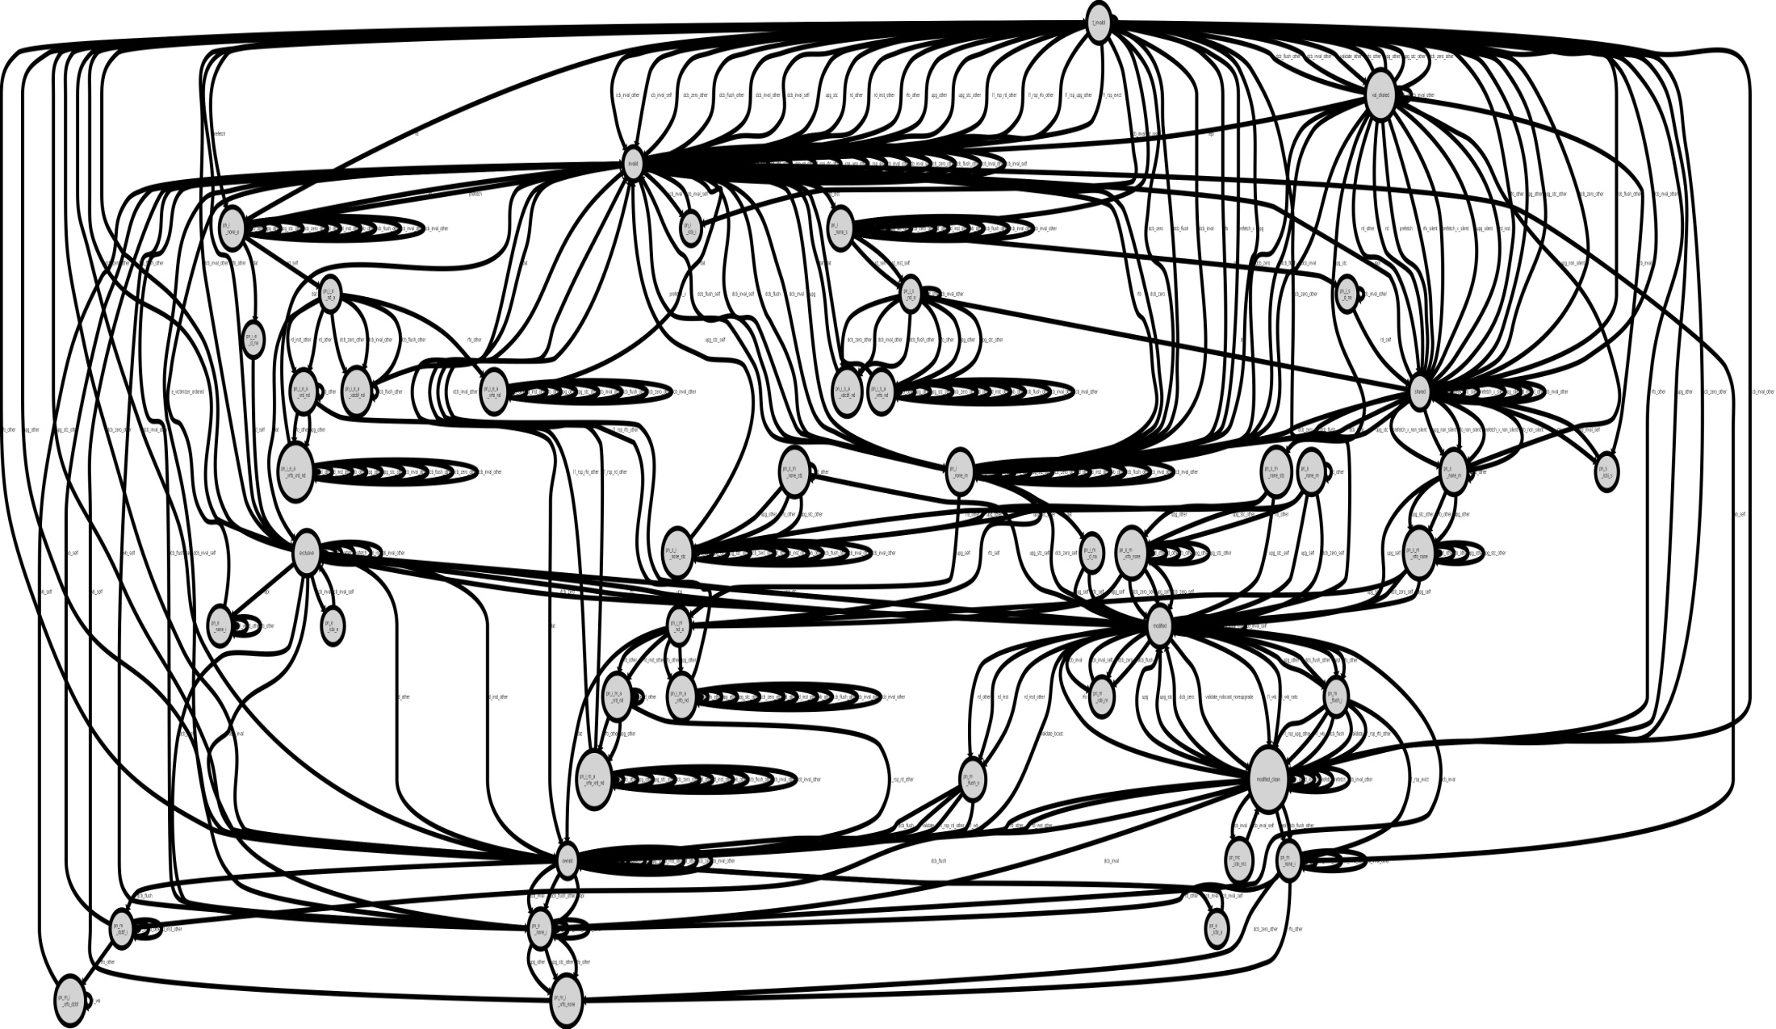
Cache coherence complexity
L2 MOETSI Transitions
[Lepak Thesis, ‘03]
Notes:
Specifying hard enough, verifying harder

Slide 25

Cache coherence verification headache
Papers:
So Many States, So Little Time:
Verifying Memory Coherence in the Cray X1
Complex Protocol
=
Complex Verification
Simple
Intel Core 2 Duo Errata:
AI39. Cache Data Access Request from One Core Hitting a Modified Line in the L1 Data Cache of the Other Core May Cause Unpredictable System Behavior
Simple
Formal Methods:
e.g. Leslie Lamport’s TLA+ specification language @ Intel

Slide 26
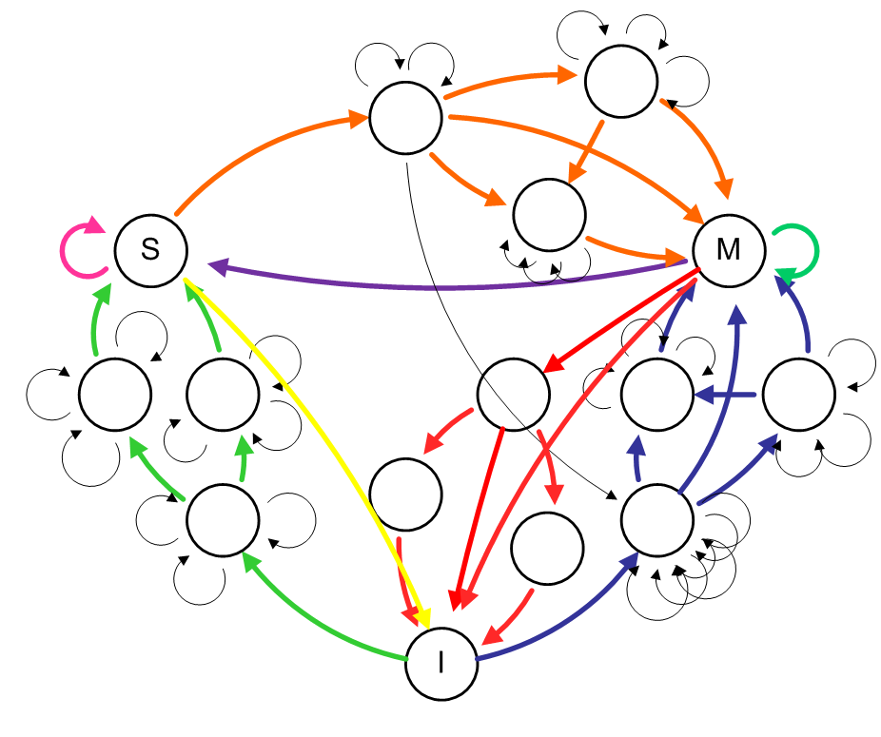
Atomic Coherence: Simplicity
w/ races
w/o races

Slide 27

Race resolution
Cause:
Concurrently active coherence requests to block A
Remedy:
Only allow one coherence request to block A to be active at a time.
Core 0
A
A
Core 1
$CACHE$
$CACHE$

Slide 28
Race resolution
Atomic Substrate
Core 0
A
Core 1
$CACHE$
$CACHE$
Coherence Substrate

Slide 29
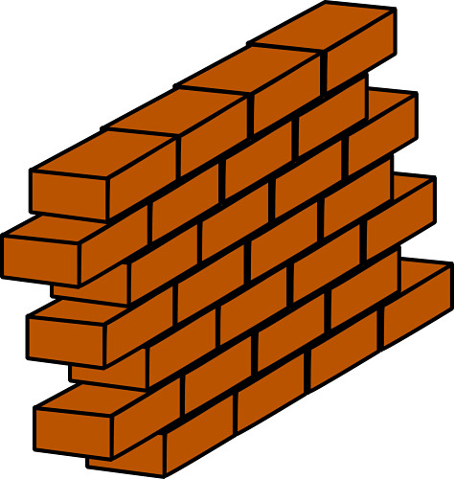
Race resolution
Atomic Substrate
Coherence Substrate
-- Atomic Substrate is on critical path
+ Can optimize substrates separately

Slide 30
Atomic & Coherence Substrates
aggressive
aggressive
Atomic Substrate
Coherence Substrate
(Apply Fancy Nanophotonics Here)
(Add speculation to a traditional protocol)

Slide 31
Mutexes circulate on ring
Single out mutex:
hash(addr X) →λ Y @ cycle Z

Slide 32
Mutex acquire
[Requesting Mutex]
[Won Mutex]
[Requesting Mutex]
Exploits OFF-resonance rings: mutex passes P1, P2 uninterrupted

Slide 33
Mutex release
[Requesting Mutex]
[Won Mutex]
[Requesting Mutex]
[Won Mutex]
[Release Mutex]
Notes:
Ring resonator is photonic magnet

Slide 34
Mutexes on ring
Detectors
Injectors
1 mutex = 200 ps = ~2cm = 1 cycle @ 5 GHz
# Mutex
Latency To:
seize free mutex : ≤ 4 cycles
tune ring resonator: < 1 cycle
2 cm

Slide 35
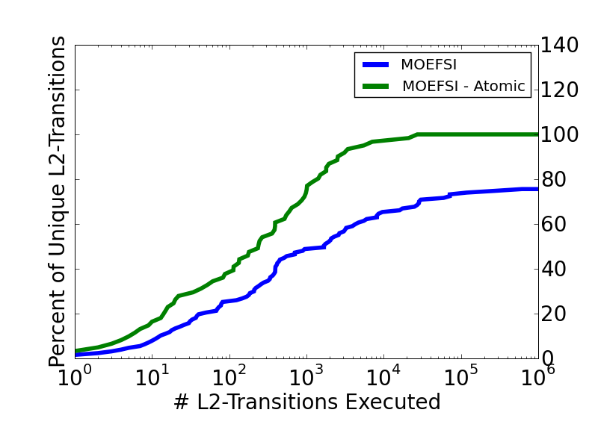
Atomic Coherence: Complexity
Static:
Dynamic:
(random tester)
* Atomic Coherence
reduces complexity
Notes:
It is hard to quantify complexity
-p64 -i10 -t50000
Traffic: Randomness in: byte from shared list, whether it will be read or written(don’t say: the makeup of the block it is in (r/w/etc))
Timing: Small randomness w/ each xbar access, large randomness with some probability (10%, 500 cycles)
Traffic random:
------------------
Random 10% of bytes were all write
Random 90% of bytes were all read
Randomly choose next block
when = i + rand() % max_spacing;
POISSON BUT NOT BINARY?
Timing random:
------------------
Random delay @ xbar, 90% time small 0 or 1 cycle delay, 10% of time big delay 500 cycles
pts.xbar.prob_big_delay = 10
pts.xbar.max_big_delay = 40000

Slide 36
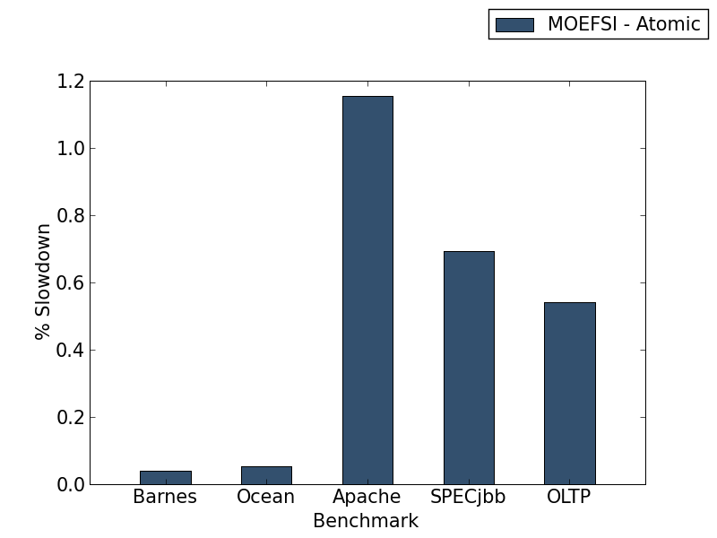
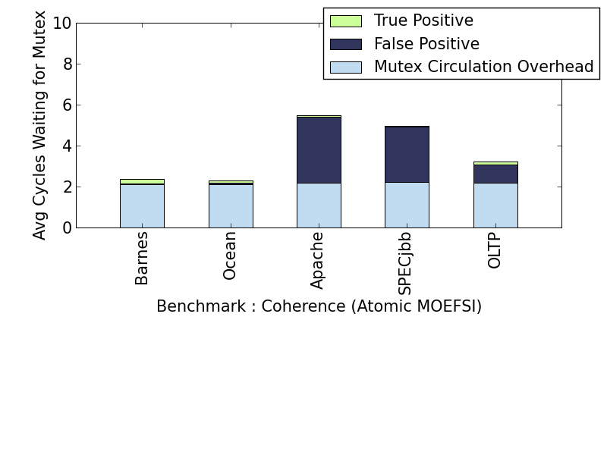
Performance
(128 in-order cores, optical data interconnect, MOEFSI directory)
Slowdown relative to non-atomic MOEFSI
What is causing the slowdown?
coherence
agnostic

Slide 37
Optimizing coherence
Observation:
Holding Block B’s mutex gives holder free reign over coherence activity related to block B
O.wned and F.orward State:
Responsible for satisfying on-chip read misses
Opportunity:
Try to keep O/F alive
If O (or F) block evicted:
While mutex is held, ‘shift’ O/F state to sharer
(or hand-off responsibility)

Slide 38
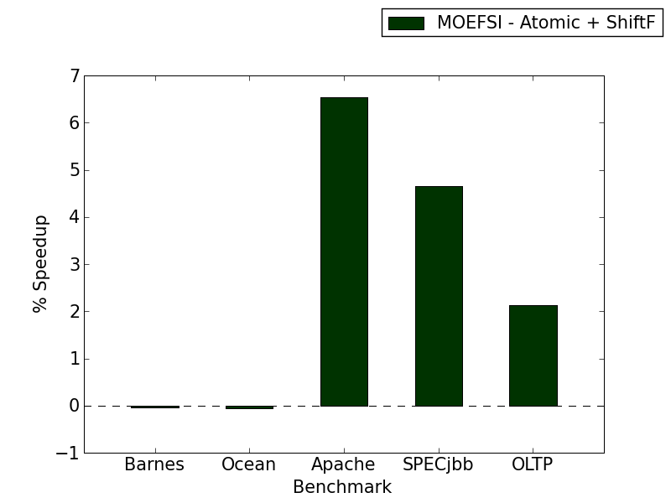
Optimizing coherence
If O (or F) block evicted: ‘Shift’ O/F state to sharer
Complexity:
Performance:
# L2 transitions
Speedup relative to atomic MOEFSI
(b/c less variety in sharing possibilities)

Slide 39
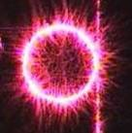
Atomic Coherence Summary
Nanophotonics as enabler
  Very fast chip-wide consensus
Atomic Protocols are simpler protocols
  And can have minimal cost to performance (w/ nanophotonics)
  Opportunity for straightforward protocol enhancements: ShiftF
More details in HPCA-11 paper
  Push protocol (update-like)
races
coherence

Slide 40
Nanophotonics
Nanophotonics overview
Sharing the nanophotonic channel
  Light-speed arbitration [MICRO 09]
Utilizing the nanophotonic channel
  Atomic coherence [HPCA 11]

